Slide 1
SR10 Car dealership Inventory
Sumin Oh
Notes:
Good morning all. Today, I am going to tell you about my shop inventory project, which is SR10 Car dealership inventory one.

Slide 2
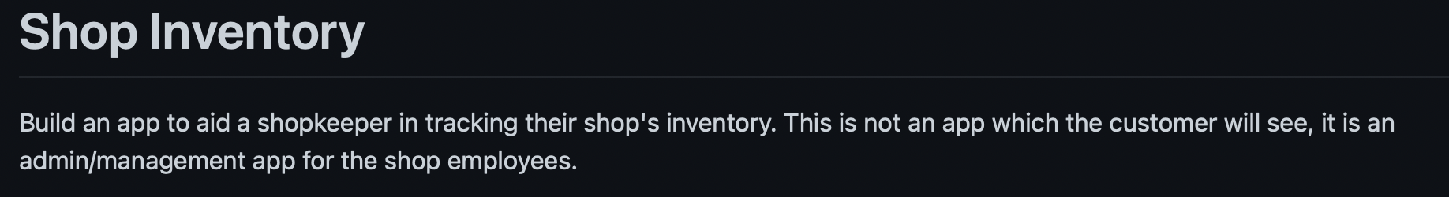
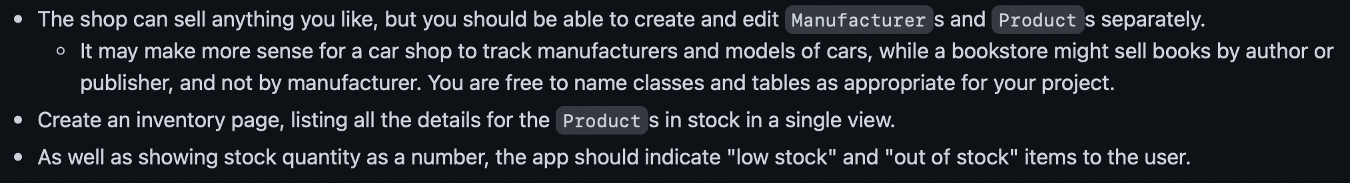

Project requirments
Notes:
Before talking about it, let’s see the requirements for the project.
I needed to build an app which is used by shop employees not by customers. The shop should create and edit manufacturers and products, in this case, models, seperately. And also it should list the details for products and shows stock number with its status (something like low stock or out of stock) If you at the last line, it is a part of extension. I need to calculate markup by subtracting buy_price from sell_price.

Slide 3
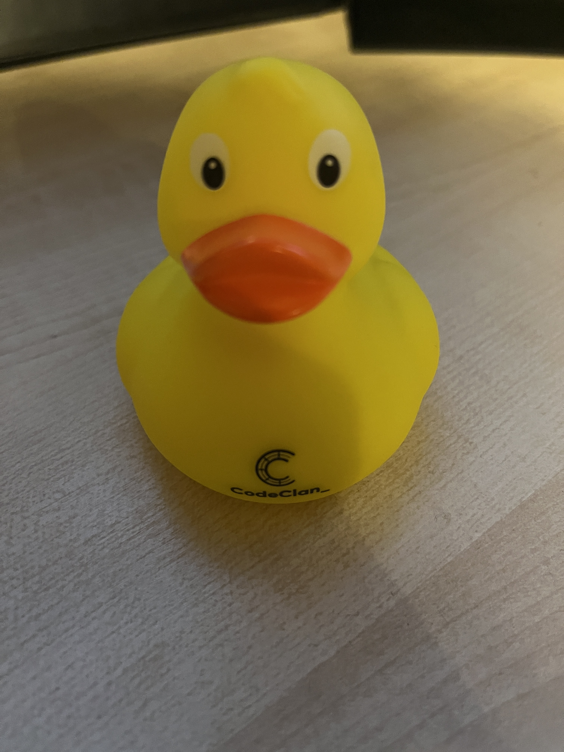
Persona/needs
Name: Rubber Duck
Demographics: 26-year-old Sales person at SR10 Car Dealership
Behaviours: Does not like to do calculation
Needs: As a sales person,
1. Wants to see all products (models) / manufacturers on website
2. Wants to create/update/delete information when there is a change
3. Wants to see stock status for each product (model)
4. Wants to get total markup for each product (model)
Notes:
Based on these requirements, I created a persona whose name is Rubber Duck. Rubber is 26-year-old sales person at SR10 Car Dealership. For behaviours, it really does not like to do calculation such as calculating markup.
For needs, as a sales person, it wants to see all models / manufacturers on the website.
It wants to create/update/delete information whenever there is a change in inventory
it wants to see stock status for each model
and lastly, it wants to get total markup for each product

Slide 4
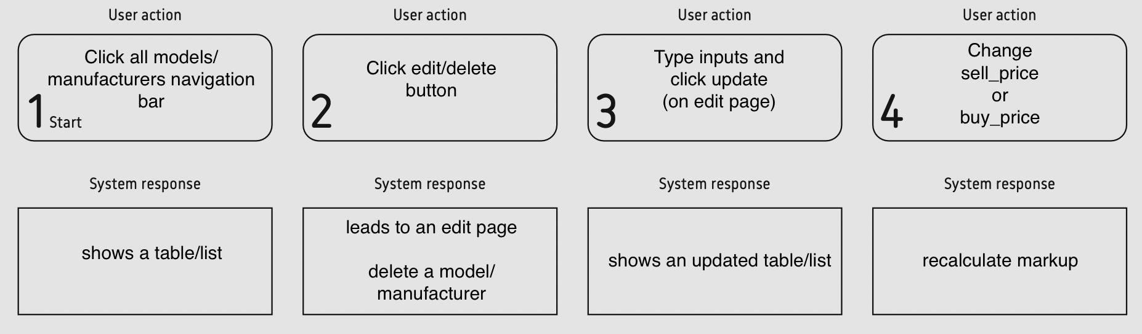
User Journey
Notes:
what about user journey?
When user click all models/manufacturers navigation bar, system shows a table or list.
similarly, when clicking edit/delete button, it leads to an edit page to make user update information.
If it is delete, then it will show a table or list excluding the deleted element.
If user types inputs and click update, it will show an updated table or list.
Lastly when user changes sell_price or buy_price, it will recalcualte markup

Slide 5

Database design: 1. Capturing requirements
Entities: products (models) and manufacturers
Attributes:
name, description, quantity, buy_price, sell_price FOR products (models)
name, position, country FOR manufacturers
3 . Relationship:
One manufacturer produces multiple products (models) (v)
One product (model) is produced by multiple manufacturers (x)
Therefore the relationship between manufacturers and products (models) is One to Many (1 – M)
Notes:
Because we are using relational database, postgressql, we need to define the relationship between model and manufacturer. I had a difficulty in identifying the relationship at planning stage but my colleuges helped me to find out right one. I found designing the database step by step is really useful when it comes to building the relationship. Based on the requirments, we can see there are two entites, which are products and manufacturers. And also we have attributes for each entity. I added position and country as any other appropriate details for manufacturer entity.
Now let's figure out the relationship. One manufactuer produces multiple models, make sense. But one product is not produced by multiple manufacturers. You might think there can be vendors which manufacture car but in this, manufacturers are only confined to car companies. For example, Toyota Prius cannot be produced by other companies like BMW.
So it is one to many relationship!

Slide 6
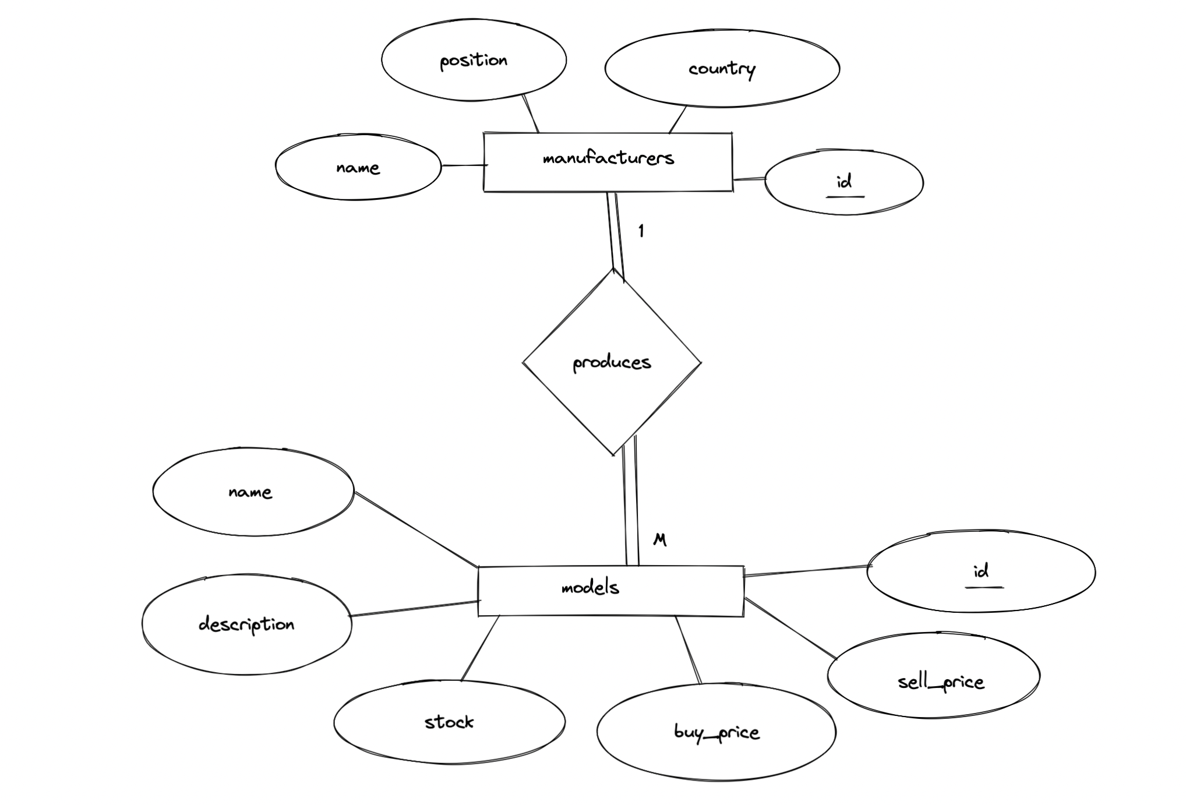
2. Entity-Relationship (ER) diagram
Notes:
We now can create ER diagram. Each entity is surrouned by square and attributes are surrounded by circles. I put 1 and m to show the relationship and underline for identifying primary key
produces is relationship but i am not going to create a table for it as it is one to many.

Slide 7
3. Schemas with Domains
manufacturers(name: VARCHAR(255), position: VARCHAR(255), country: VARCHAR(255), id: SERIAL PRIMARY KEY)
models(name: VARCHAR(255), description: VARCHAR(255), stock: INT, buy_price: FLOAT, sell_price: FLOAT, manufacturer_id: INT REFERENCES, id SERIAL PRIMARY KEY)
FOREIGN KEY!
primary key
Notes:
This is schemas with domains. Domain is basically data type. So we simply put foreign key attribute in models, which is on m (many) side.
id highlighted in yellow will be primary key in both cases.

Slide 8
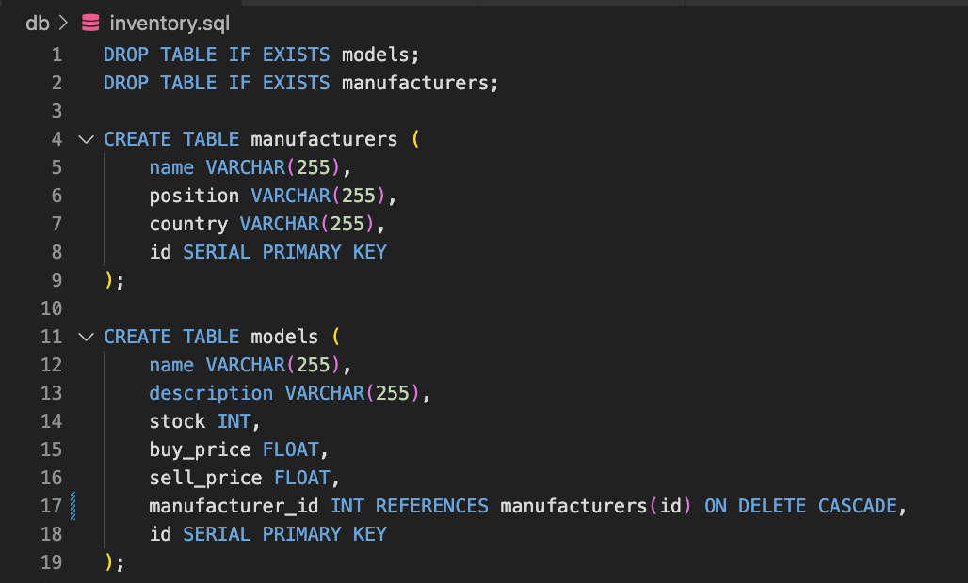
4. Implementation of the schemas on RDB
Notes:
This is just a screenshot of the implementation of the schemas on relational database

Slide 9
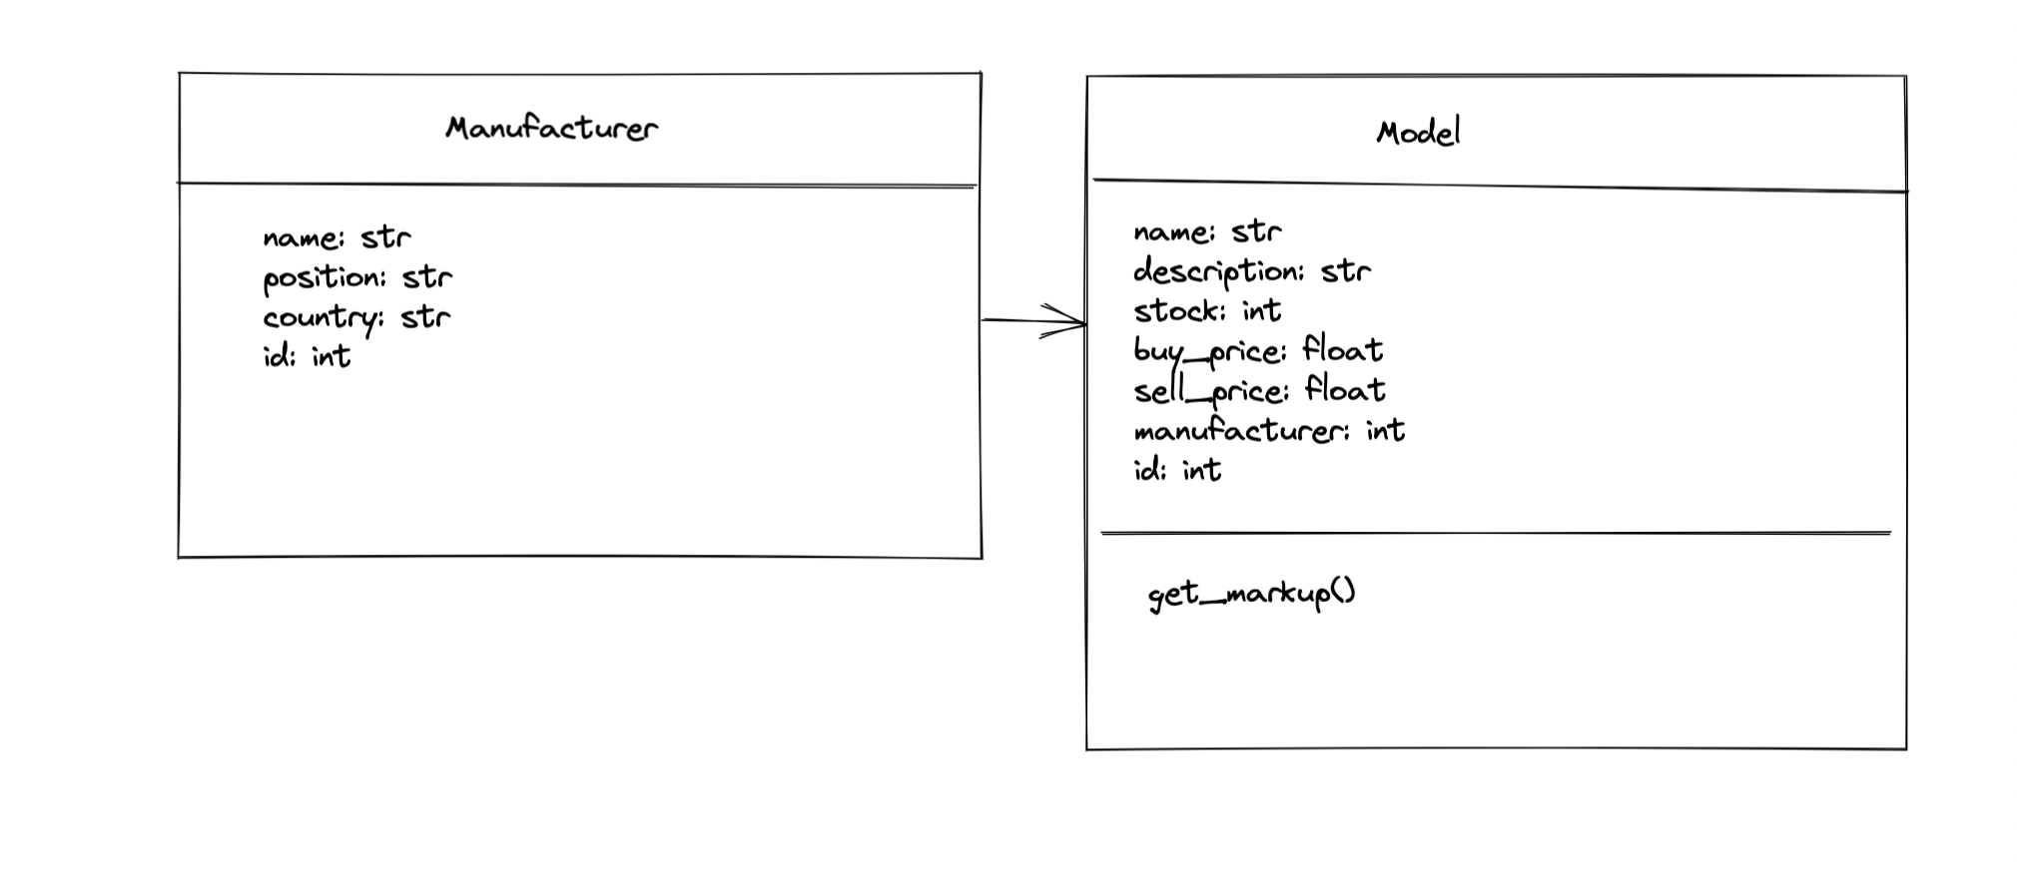
Class diagram
Notes:
Based on that, we can also create class diagram. I have just changed varchar(255) in database to str in order to be used in Python. And also i put method called 'get markup' under model class for extension part.

Slide 10
Sketches/Demo
/models
/models/new
Car Inventory Home All models All manufacturers
Add model
SR10 Car Dealership
Car Inventory Home All models All manufacturers
Name: Description: Stock: Buy price: Sell price: Manufacturer:
SR10 Car Dealership
Name | Description | Stock | Stock status | Buy price | Sell price | markup | manufacturer
 |  |  |  |  |  |  |  | View/ Edit | Delete
 |  |  |  |  |  |  |  | View/ Edit | Delete
 |  |  |  |  |  |  |  | View/ Edit | Delete
Add Model
Notes:
These are two wireframes that look very identical to my app. We have footer here with title and navigation bar
and CRUD action in main
and this is footer that shows the name of shop
same for the next one
header
main where you can input the details for model and add that model
and footer underneath
now let's show my app

Slide 11
(self) Heuristic evaluation for User Interface design
1. Visibility of system status (x)
2. Match between system and the real world (v)
3. User control and freedom (v)
4. Consistency and standards (v)
5. Error prevention (x)
6. Recognition rather than recall (v)
7. Flexibility and efficieny of use (x)
8. Aesthetic and minimalist design (x)
9. Help users recognise, diagnose, and recover from errors (x)
10. Help and documentation (v)
Source: Nielsen, 1994
Notes:
This is a list of principles for good user interface design. I am not going to read all but only things that my app does not satisfy.
Start with visibility of system status, after i click update button on edit page, it does not give any message like 'updated' so it does not give visibilty of system status.
Error prevention is something like when you try to give input to the app, it automatiicaly shows a recommnded keywords relating to your input. Mine does not have that feature. So no error prevention here.
Flexiblity and efficiency of use is something i have to fix immediately. This can include some useful features like filter by (manufacturers) or some shortcuts.
My app is not aesthetic at all but minimal because there only a small number of features. My priority was to make my app work.
And lastly, help users recognise, diagnose and recover from errors. If you type negative integer in sale_price it should cause an error message, but it does not. I think this isnt something i can fix at this stage because i have a lot to learn
So this is the end of my presentation Thank you for listening.
Heuristic: enabling to find something

